Slide 1
Advanced Programming
Group 7:
Ngo Quynh Nga
Duong Tien Thanh
Hoang Cong Minh
Pham Le Hai Dang

Slide 2

Object-Oriented Programming (OOP)
Object-oriented programming(OOP) combines a collection of variables (properties) and functions (methods) into a single entity known as an "object." These items are classified into classes, which allow individual objects to be grouped together. OOP may assist you in considering objects in a program's code and the many activities that could occur in connection to the objects.
This programming approach is prevalent in widely known programming languages such as Java, C++, and PHP. These languages aid in the organization and structure of software applications. When creating complicated applications, programmers frequently utilize OOP.

Slide 3
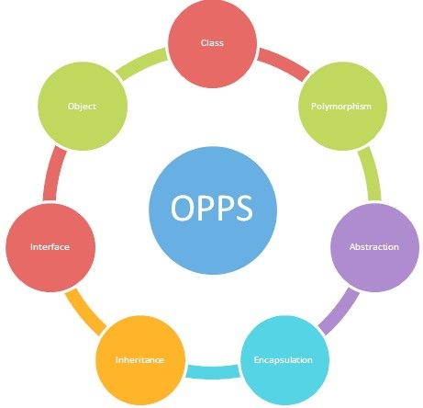
Characteristic of OOP
Encapsulation: Classes cannot alter or interact with an object's particular variables and functions due to the encapsulation process.
Abstraction: Abstraction helps to isolate the impact of code modifications so that if something goes wrong, the change only affects the variables presented and not the outside code.
Inheritance: Using this idea, programmers may expand the functionality of existing classes in the code to reduce redundant code.
Polymorphism: Overriding and overloading are polymorphism terms.
Objects and Methods: An object is a collection of data, procedures for manipulating the data, and functions that provide data-related information. Methods refer to both procedures and functions
Class: All members defined in the declarations will be present in each object in the class.

Slide 4
Advantages of OOP
OOP supports the modular framework for application development and offers it. Good definitions are implemented by concealing internal information, abstract data types are implemented.
The retention and modification of the current code is easy, whilst existing code may be changed to existing objects with little modifications.
The OOP provides an excellent code library foundation for quickly adjusting and modifying program components.

Slide 5
Scenario
The selling system will be used as an example for OOP. There are three actors in this system: the customer, the seller, and the administrator. Login, search products, check details, and buy products are all available to customers. The seller can log in, search products, enter data, and check for client information such as phone numbers, etc. The administrator can log in, search for and manage all client information. Admins can also add, update, and delete products, as well as change their prices based on market conditions. There will be a memory for all of the items that will keep track of all of the locations that they have added. Memory can be managed by the administrator, but not by customers, and memory data cannot be removed. Customers can only buy products after registering an account.

Slide 6
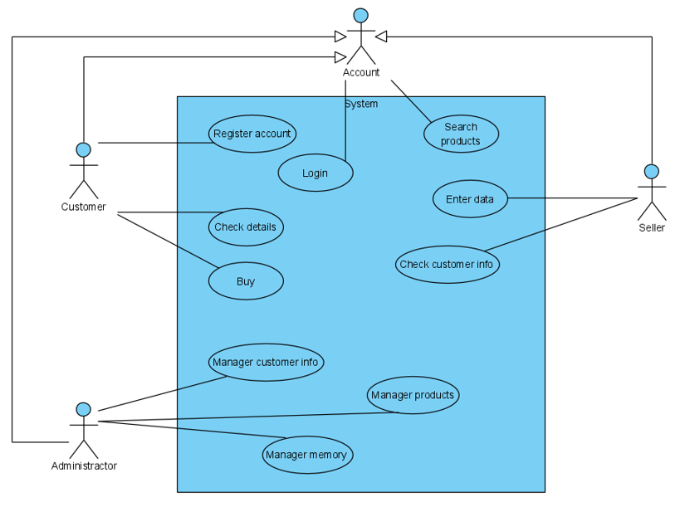
Use case diagram (Scenario)

Slide 7
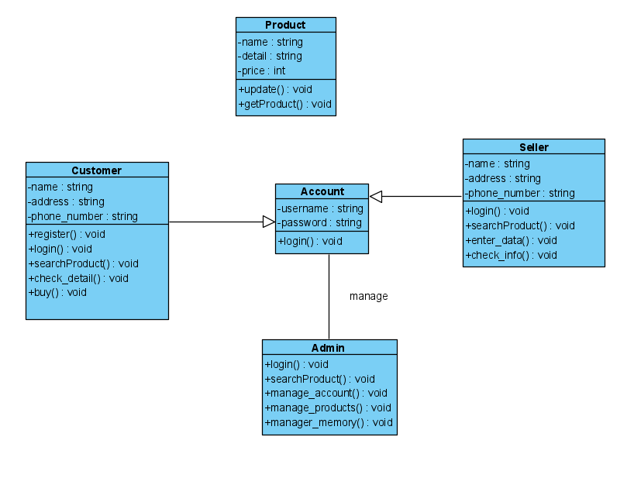
Class diagram (Scenario)

Slide 8
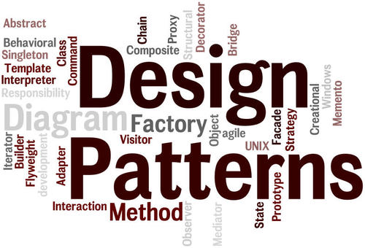
Design patterns
Design Patterns are a technique in object-oriented programming. Design Pattern is used frequently in OOP languages. It provides you with “design patterns”, solutions to common problems, commonly encountered in programming. The problems you face may be your own to come up with a solution, but it may not be optimal. Design Pattern helps you solve problems in the most optimal way, providing you with solutions in OOP programming

Slide 9
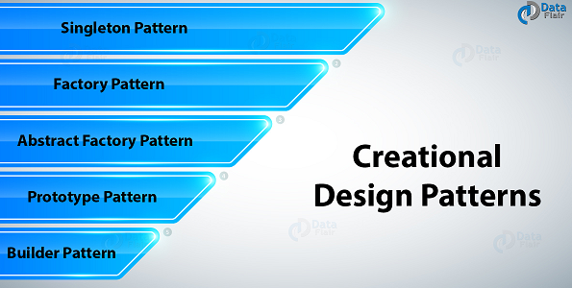
Creational pattern
These design patterns are all about class instantiation. This pattern can be further divided into class-creation patterns and object-creational patterns. While class-creation patterns use inheritance effectively in the instantiation process, object-creation patterns use delegation effectively to get the job done
Abstract Factory
Builder
Factory Method
Object Pool
Prototype
Singleton

Slide 10
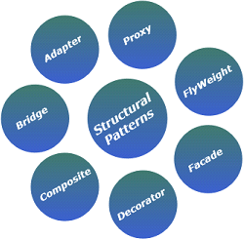
Structural pattern
These design patterns are all about Class and Object composition. Structural class-creation patterns use inheritance to compose interfaces. Structural object-patterns define ways to compose objects to obtain new functionality.
Adapter
Bridge
Composite
Decorator
Façade
Flyweight
Private Class Data
Proxy

Slide 11
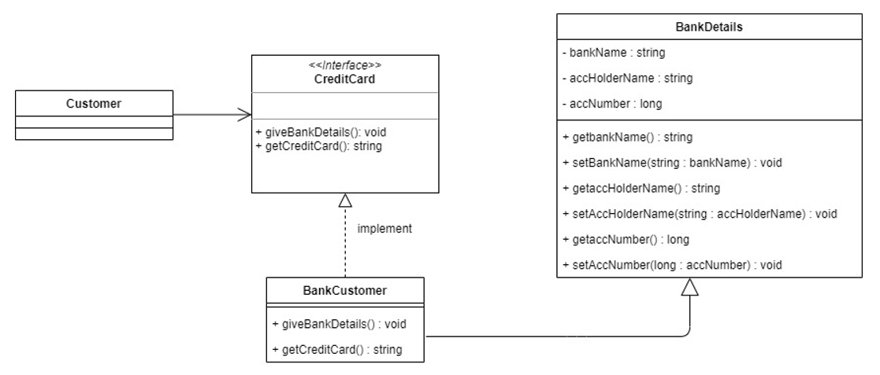
Adapter Design Pattern
Adapter Pattern is one of the Patterns in the Structural Pattern group. The Adapter Pattern allows unrelated interfaces to work together without having to modify them directly. The object that helps to connect the interfaces is called Adapter
Client
Target
Adaptee
Adapter

Slide 12
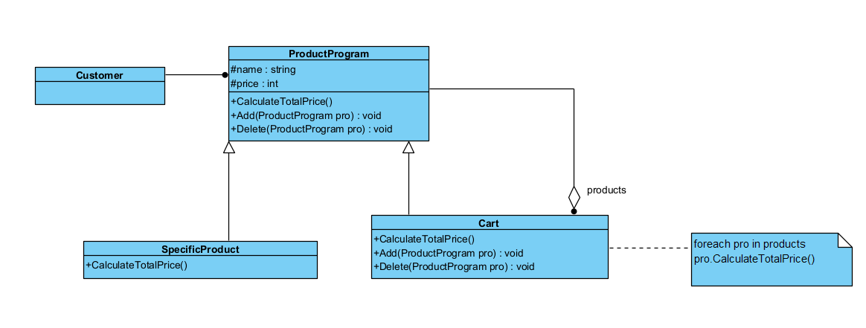
Composite Design Pattern
A composite's purpose is to "compose" things into tree structures in order to express part-whole hierarchies.
Component:
Leaf:
Composite:
Client:

Slide 13
Behavioral pattern
These design patterns are all about Class's objects communication. Behavioral patterns are those patterns that are most specifically concerned with communication between objects.
Chain of responsibility
Command
Interpreter
Iterator
Mediator
Memento
Null Object
Observer
State
Strategy
Template method
Visitor

